Slide 1
JaveOne4Kids 2017
Lego Mindstorms workshop
September 30 2017

Slide 2

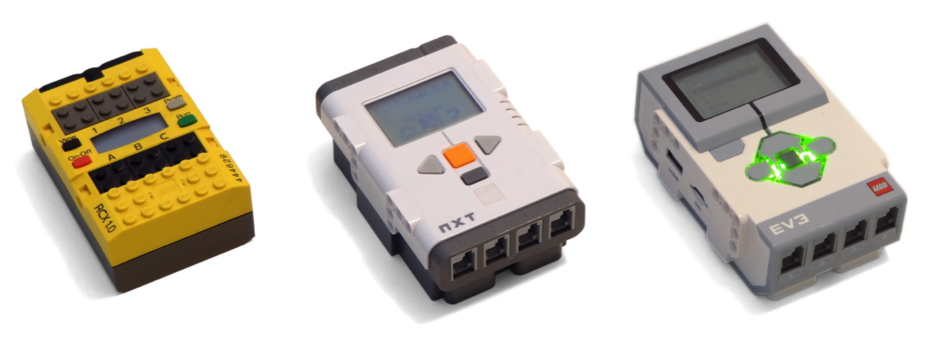
LeJOS
How it works on the EV3
Slide copied from: http://www.slideshare.net/steveonjava/devoxx4kids-lego-workshop?ref=http://steveonjava.com/java-lego-workshop-4-kids/

Slide 3
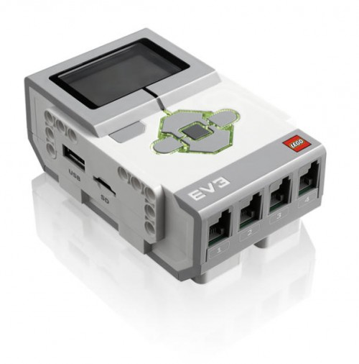
The Heart of the EV3
TI Sitara AM1808
ARM9, 300Mhz
64MB RAM / 16MB Flash
Analog to Digital Converter
4 Motor Ports
4 Sensor Ports
Bluetooth / USB
MicroSD
Slide copied from: http://www.slideshare.net/steveonjava/devoxx4kids-lego-workshop?ref=http://steveonjava.com/java-lego-workshop-4-kids/

Slide 4
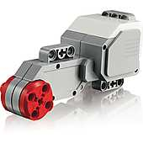
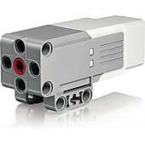
EV3 Motors
Slide copied from: http://www.slideshare.net/steveonjava/devoxx4kids-lego-workshop?ref=http://steveonjava.com/java-lego-workshop-4-kids/

Slide 5
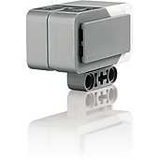
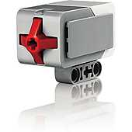
EV3 Sensors
Slide copied from: http://www.slideshare.net/steveonjava/devoxx4kids-lego-workshop?ref=http://steveonjava.com/java-lego-workshop-4-kids/

Slide 6
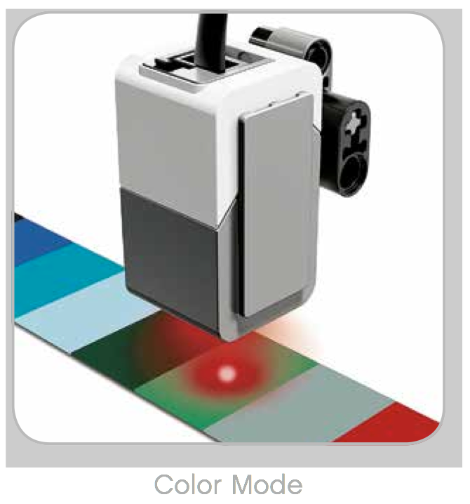
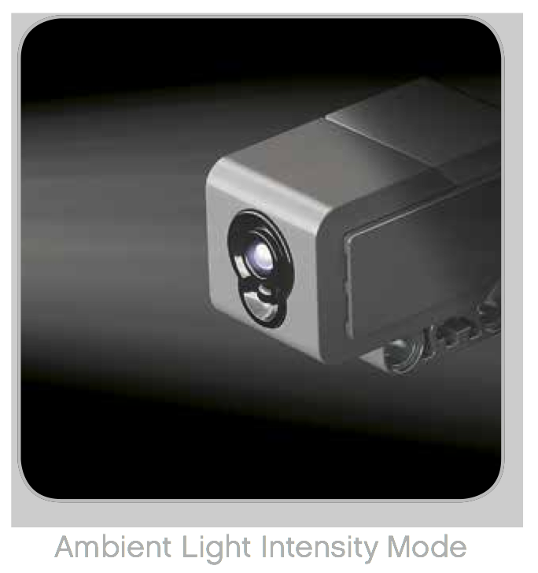
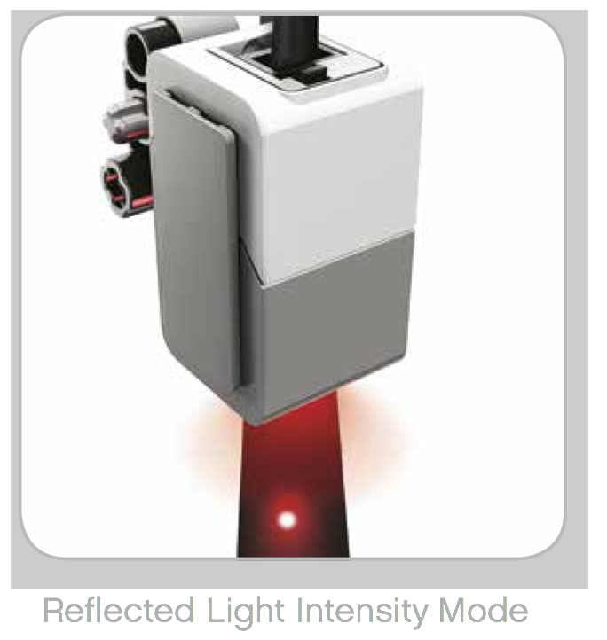
Color and Light Sensor
Slide copied from: http://www.slideshare.net/steveonjava/devoxx4kids-lego-workshop?ref=http://steveonjava.com/java-lego-workshop-4-kids/

Slide 7
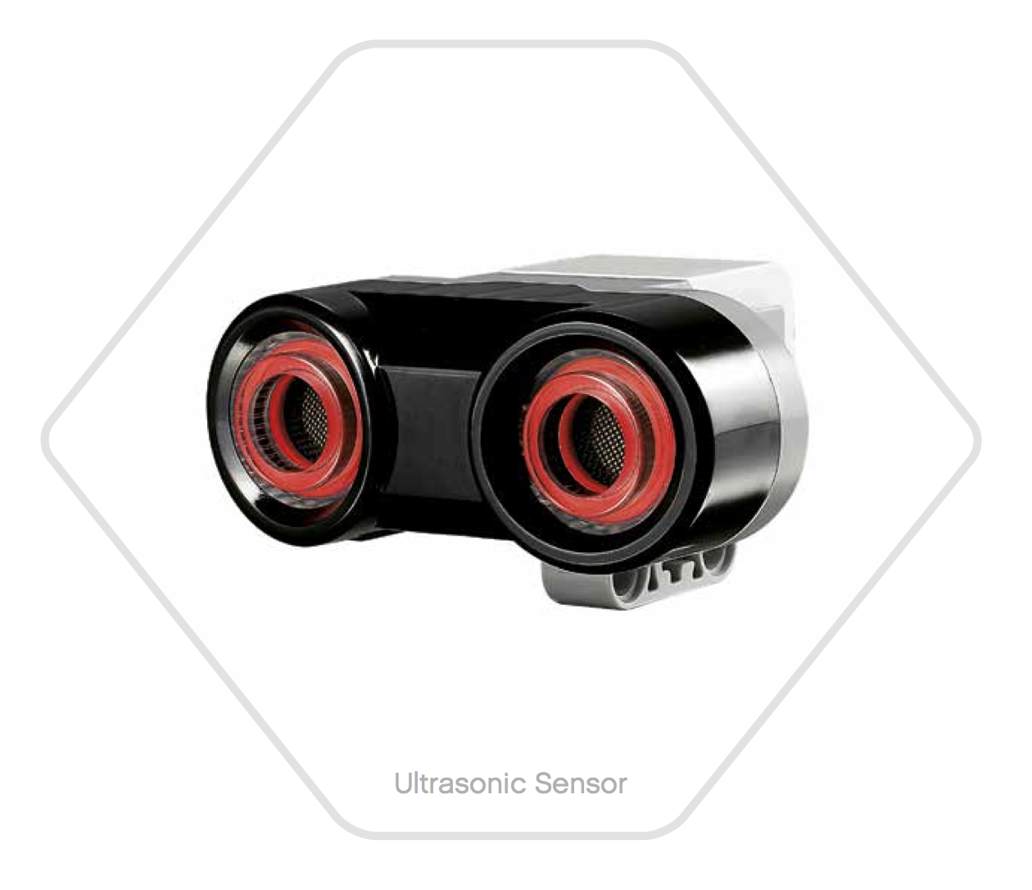
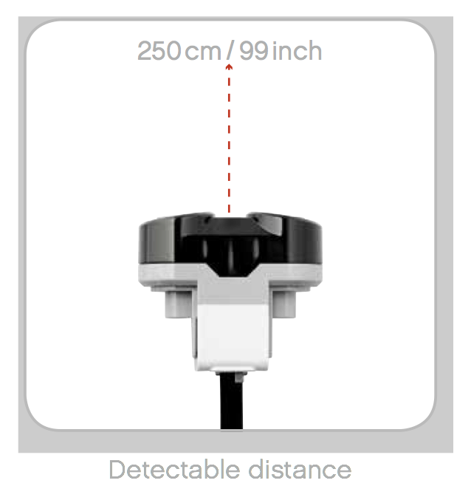
Ultrasonic Sensor
High frequency
sound waves
Measuring mode Vs Presence Mode
Slide copied from: http://www.slideshare.net/steveonjava/devoxx4kids-lego-workshop?ref=http://steveonjava.com/java-lego-workshop-4-kids/

Slide 8
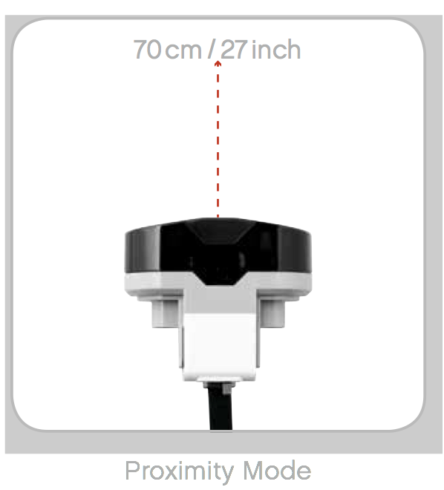
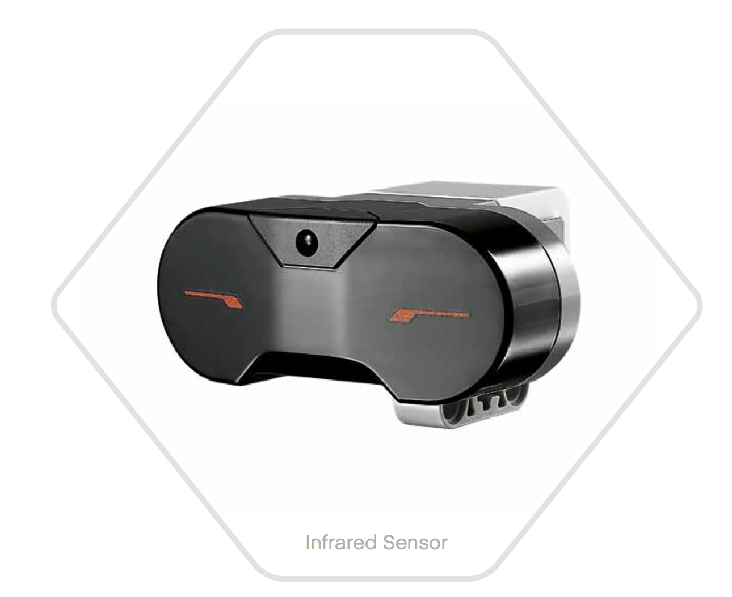
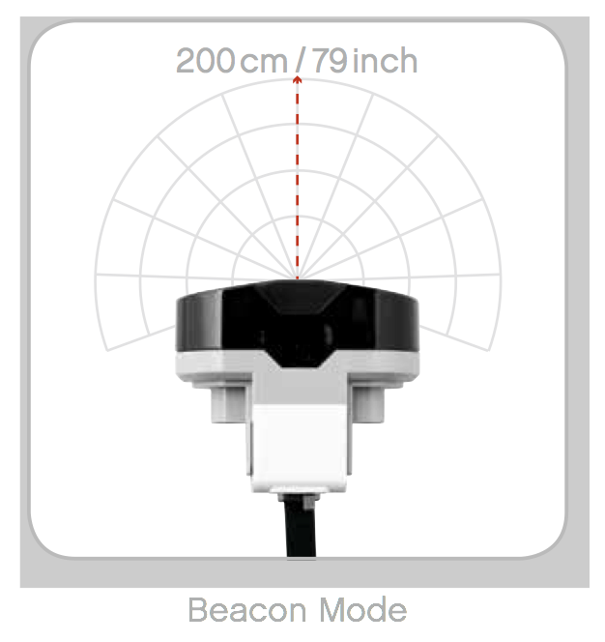
Infrared Sensor
Slide copied from: http://www.slideshare.net/steveonjava/devoxx4kids-lego-workshop?ref=http://steveonjava.com/java-lego-workshop-4-kids/

Slide 9
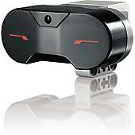
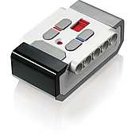
Remote Control
Slide copied from: http://www.slideshare.net/steveonjava/devoxx4kids-lego-workshop?ref=http://steveonjava.com/java-lego-workshop-4-kids/

Slide 10


Getting Started with LeJOS
Creating Your SD Card
Micro SD Card (> 2GB)
Compatible WIFI adapter
NetGear WNA1100
EDIMAX EW-7811Un
Linux (or a Linux VM)
Details here:
http://sourceforge.net/p/lejos/wiki/Home/
Slide copied from: http://www.slideshare.net/steveonjava/devoxx4kids-lego-workshop?ref=http://steveonjava.com/java-lego-workshop-4-kids/

Slide 11
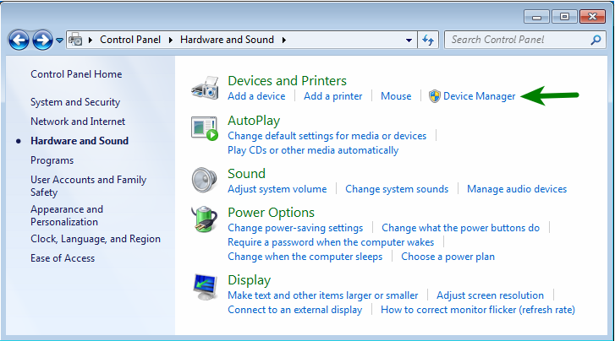
Windows USB Connection
Step 1: The wrong driver gets installed, so we need to fix this in the Device Manager
Slide copied from: http://www.slideshare.net/steveonjava/devoxx4kids-lego-workshop?ref=http://steveonjava.com/java-lego-workshop-4-kids/
Credit to the ev3dev team for the great screen captures and writeup: http://www.ev3dev.org/docs/tutorials/connecting-to-the-internet-via-usb/?tabs-0=windows-7-8

Slide 12
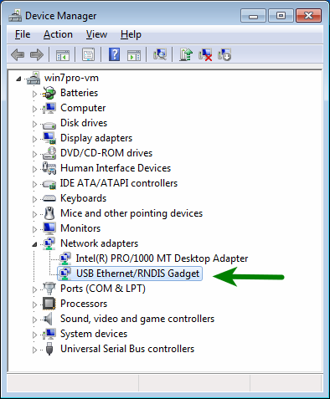
Windows USB Connection
Step 2: In Device Manager, find your EV3’s RNDIS device. It is under Network Adapters > USB Ethernet/RNDIS Gadget.
Slide copied from: http://www.slideshare.net/steveonjava/devoxx4kids-lego-workshop?ref=http://steveonjava.com/java-lego-workshop-4-kids/
Credit to the ev3dev team for the great screen captures and writeup: http://www.ev3dev.org/docs/tutorials/connecting-to-the-internet-via-usb/?tabs-0=windows-7-8

Slide 13
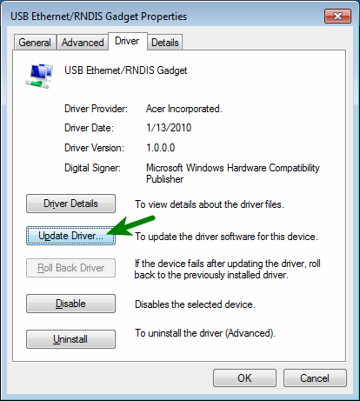
Windows USB Connection
Step 3: Double-click it and select the Drivers tab. Click Update driver… to change the driver.
Slide copied from: http://www.slideshare.net/steveonjava/devoxx4kids-lego-workshop?ref=http://steveonjava.com/java-lego-workshop-4-kids/
Credit to the ev3dev team for the great screen captures and writeup: http://www.ev3dev.org/docs/tutorials/connecting-to-the-internet-via-usb/?tabs-0=windows-7-8

Slide 14
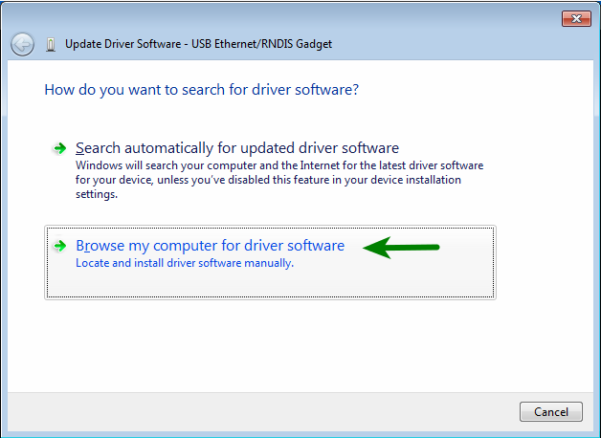
Windows USB Connection
Step 4: Select Browse my computer for driver software.
Slide copied from: http://www.slideshare.net/steveonjava/devoxx4kids-lego-workshop?ref=http://steveonjava.com/java-lego-workshop-4-kids/
Credit to the ev3dev team for the great screen captures and writeup: http://www.ev3dev.org/docs/tutorials/connecting-to-the-internet-via-usb/?tabs-0=windows-7-8

Slide 15
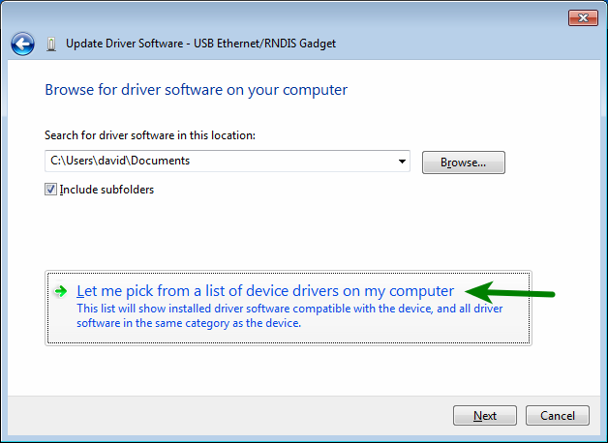
Windows USB Connection
Step 5: Click Let me pick from a list of device drivers on my computer.
Slide copied from: http://www.slideshare.net/steveonjava/devoxx4kids-lego-workshop?ref=http://steveonjava.com/java-lego-workshop-4-kids/
Credit to the ev3dev team for the great screen captures and writeup: http://www.ev3dev.org/docs/tutorials/connecting-to-the-internet-via-usb/?tabs-0=windows-7-8

Slide 16
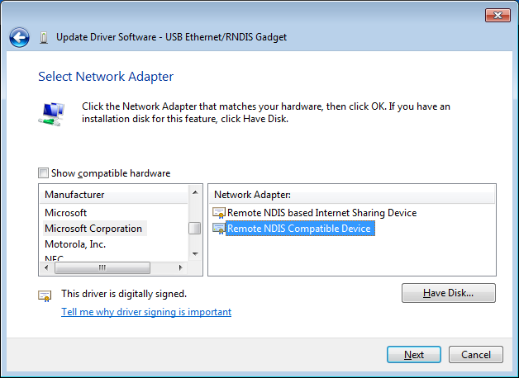
Windows USB Connection
Step 6: Uncheck the box that says Show compatible hardware. In the Manufacturer list, pick Microsoft Corporation (in Windows 8, pick Microsoft). In the Network Adapter list, pick Remote NDIS Compatible Device. Then click Next.
Slide copied from: http://www.slideshare.net/steveonjava/devoxx4kids-lego-workshop?ref=http://steveonjava.com/java-lego-workshop-4-kids/
Credit to the ev3dev team for the great screen captures and writeup: http://www.ev3dev.org/docs/tutorials/connecting-to-the-internet-via-usb/?tabs-0=windows-7-8

Slide 17
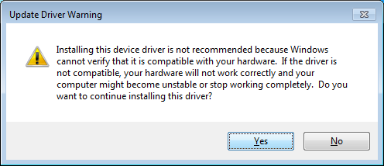
Windows USB Connection
Step 7: Windows thinks we don’t know what we are doing, but really we do, so click Yes.
Slide copied from: http://www.slideshare.net/steveonjava/devoxx4kids-lego-workshop?ref=http://steveonjava.com/java-lego-workshop-4-kids/
Credit to the ev3dev team for the great screen captures and writeup: http://www.ev3dev.org/docs/tutorials/connecting-to-the-internet-via-usb/?tabs-0=windows-7-8

Slide 18
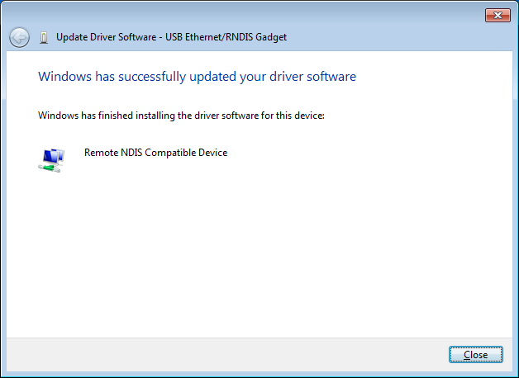
Windows USB Connection
Step 8: When it is done installing, click Close.
Slide copied from: http://www.slideshare.net/steveonjava/devoxx4kids-lego-workshop?ref=http://steveonjava.com/java-lego-workshop-4-kids/
Credit to the ev3dev team for the great screen captures and writeup: http://www.ev3dev.org/docs/tutorials/connecting-to-the-internet-via-usb/?tabs-0=windows-7-8

Slide 19
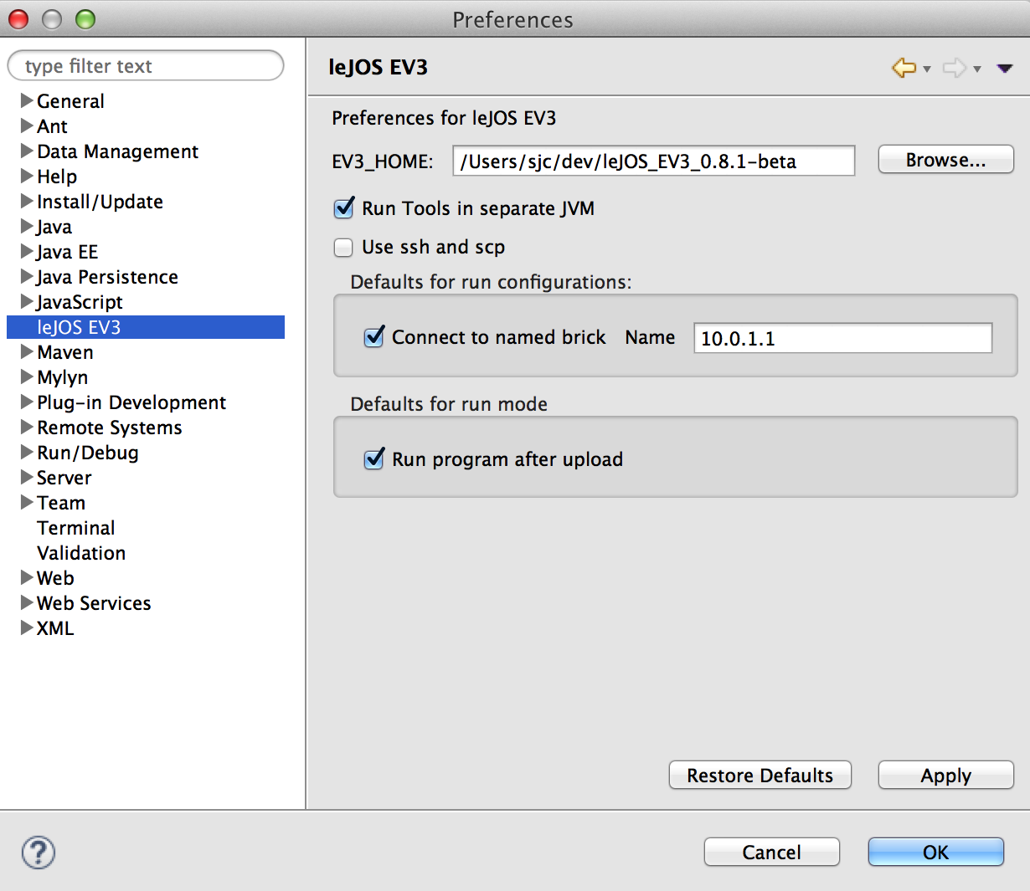
Eclipse Setup
Open Eclipse
Go to "Preferences"
Click on leJOS EV3
Change the brick name to the IP address of your brick
(default is 10.0.1.1)
Slide copied from: http://www.slideshare.net/steveonjava/devoxx4kids-lego-workshop?ref=http://steveonjava.com/java-lego-workshop-4-kids/

Slide 20
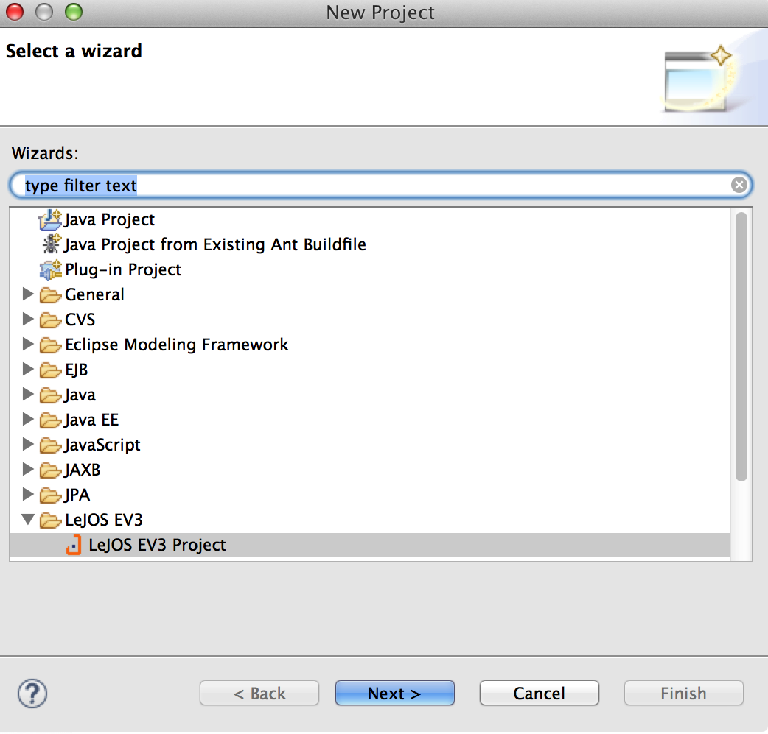
Creating a New LeJOS Project
Go to "File" > "New" > "Project…"
Choose a LeJOS EV3 Project
Slide copied from: http://www.slideshare.net/steveonjava/devoxx4kids-lego-workshop?ref=http://steveonjava.com/java-lego-workshop-4-kids/

Slide 21
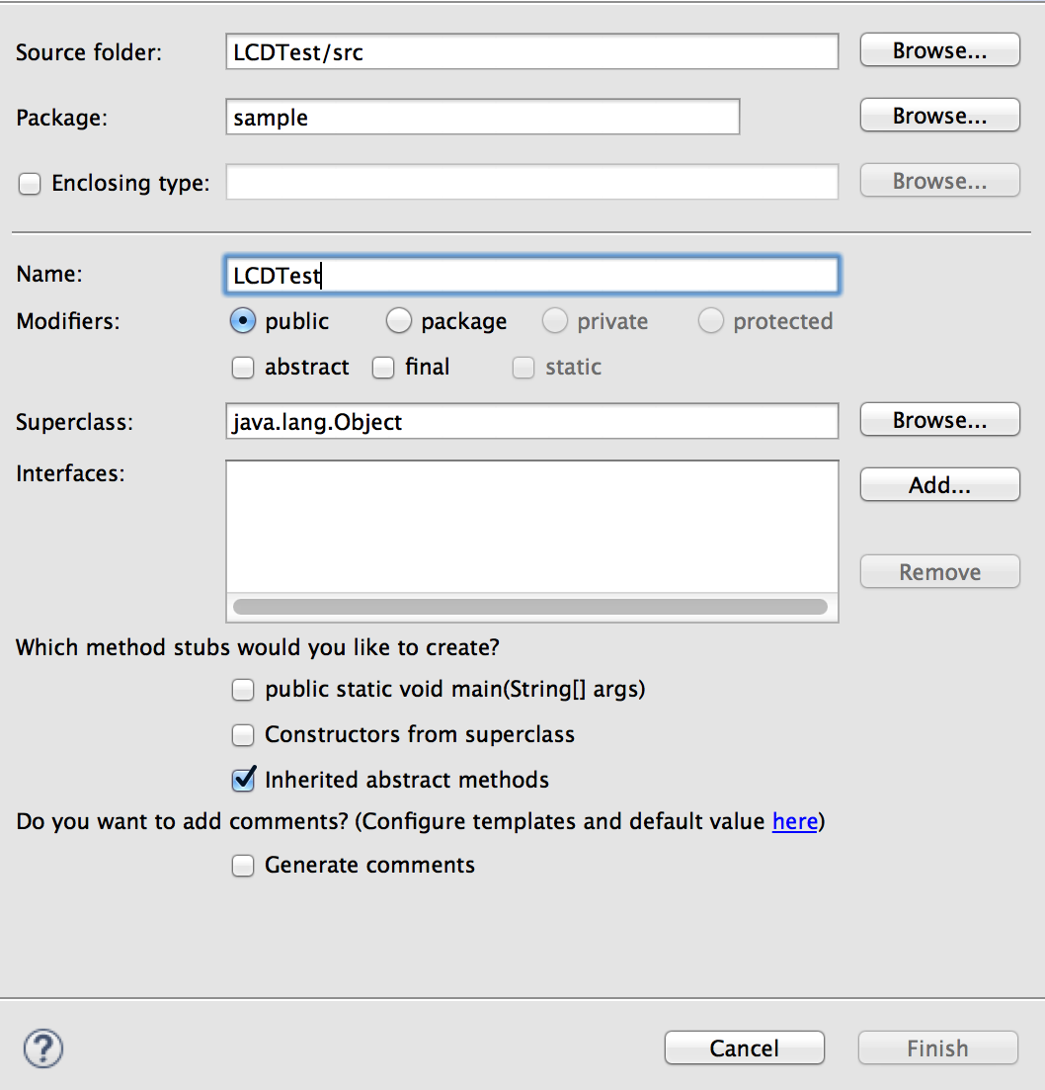
Create a Class File
Create a new class ("File" > "New" > "Class")
Give it a package (e.g. sample)
Give it a name (e.g. LCDTest)
Slide copied from: http://www.slideshare.net/steveonjava/devoxx4kids-lego-workshop?ref=http://steveonjava.com/java-lego-workshop-4-kids/

Slide 22
Simple LeJOS Application
public class EV3FirstProgram {
public static void main(String[] args) {
LCD.clear();
LCD.drawString("First EV3 Program", 0, 5);
Button.waitForAnyPress();
LCD.clear();
LCD.refresh();
}
}
Slide copied from: http://www.slideshare.net/steveonjava/devoxx4kids-lego-workshop?ref=http://steveonjava.com/java-lego-workshop-4-kids/

Slide 23
Create and Program Lift

Slide 24
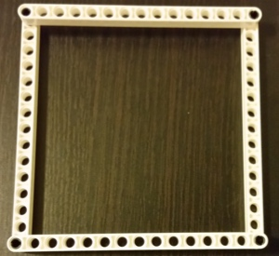
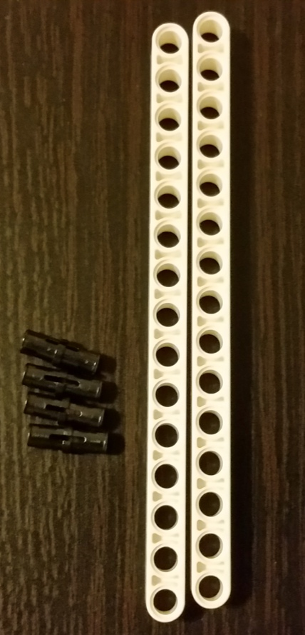
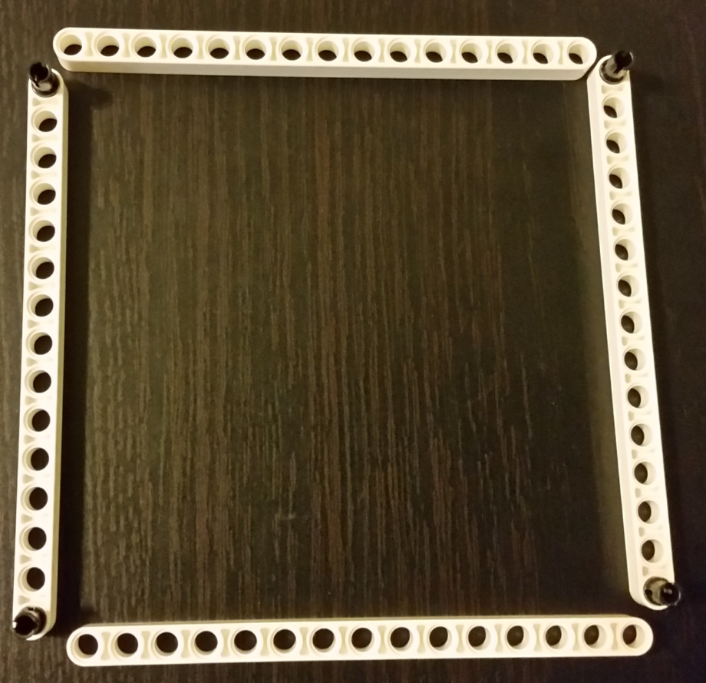
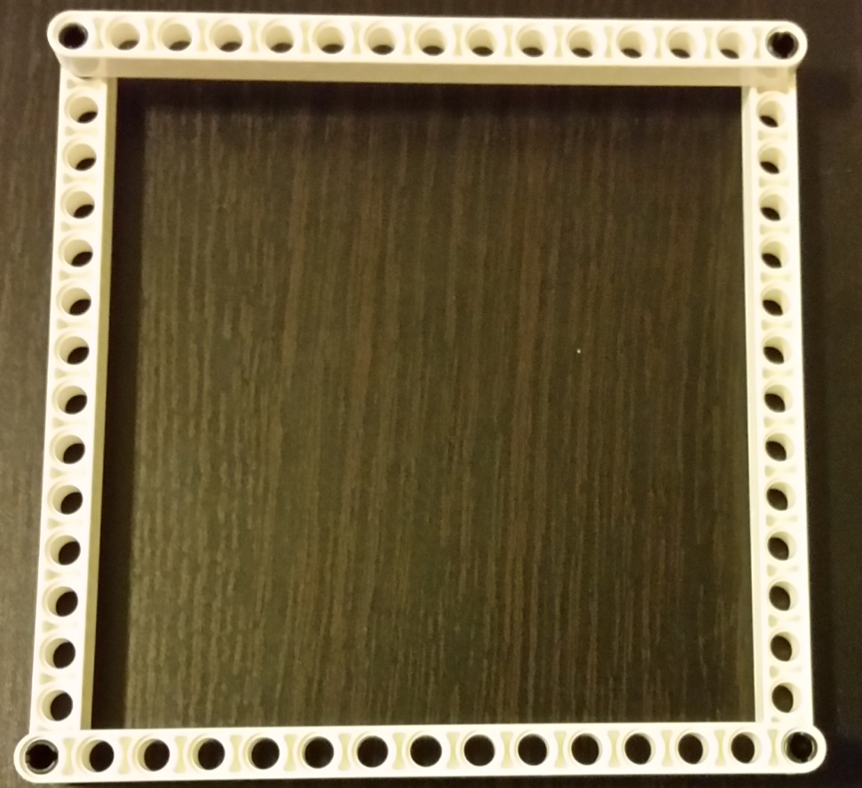
Build Base

Slide 25
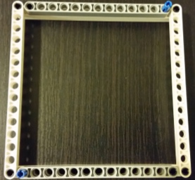
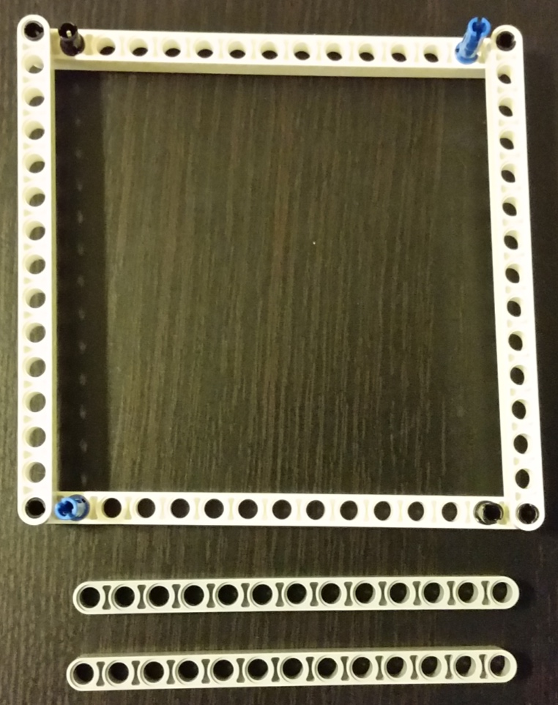
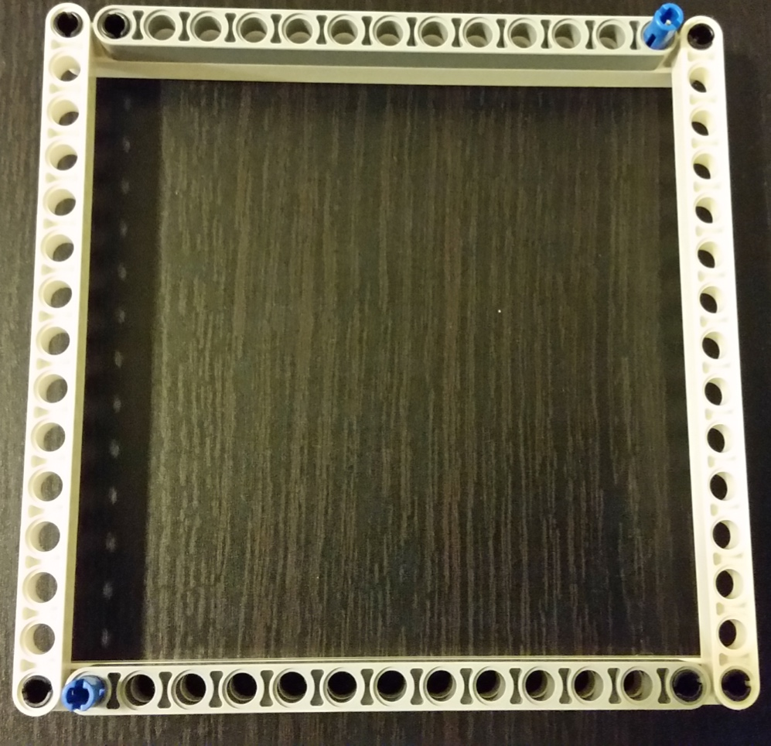
Build Base

Slide 26
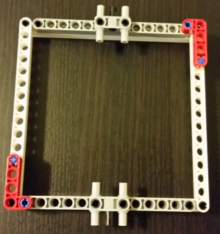
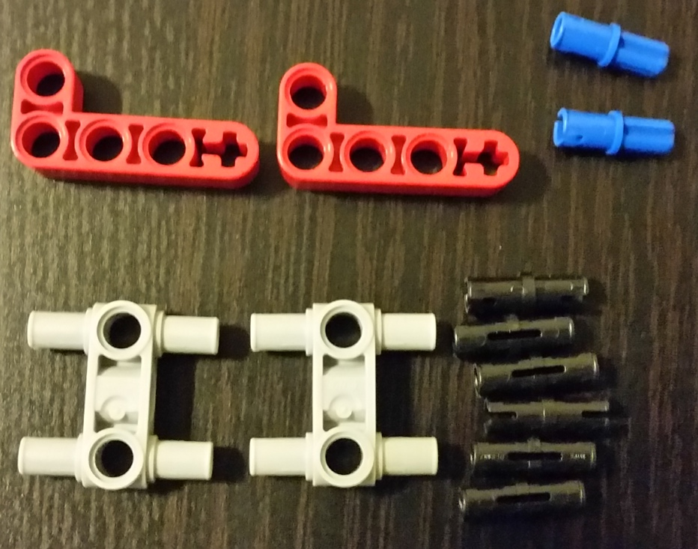
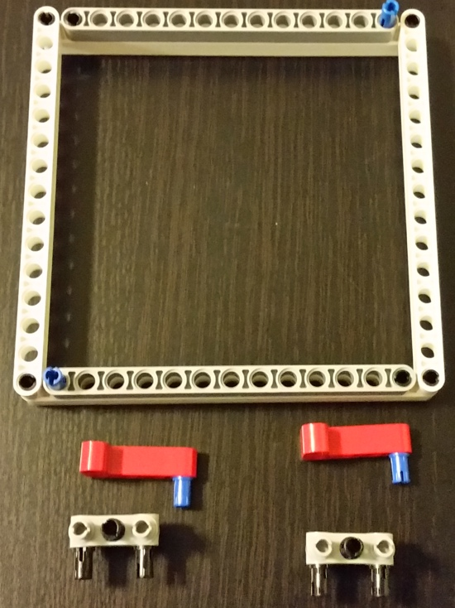
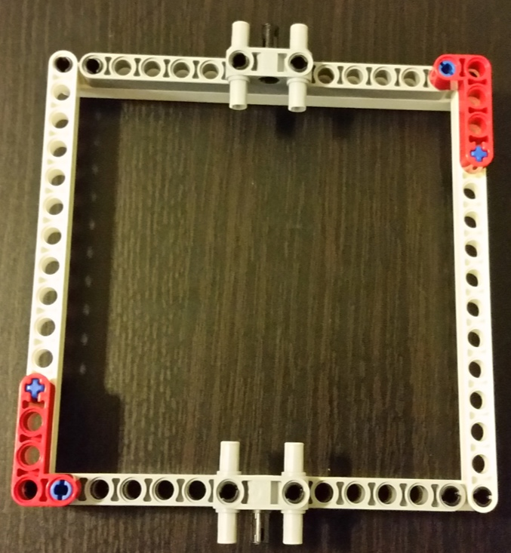
Reinforce Base

Slide 27
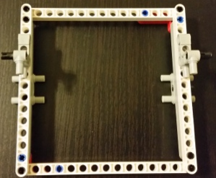
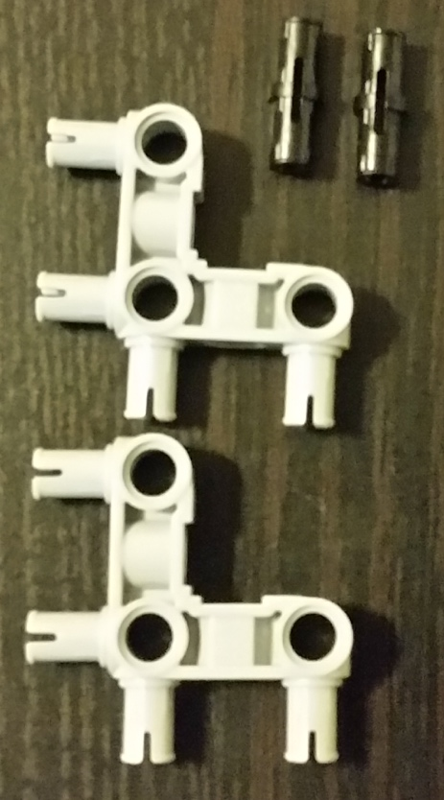
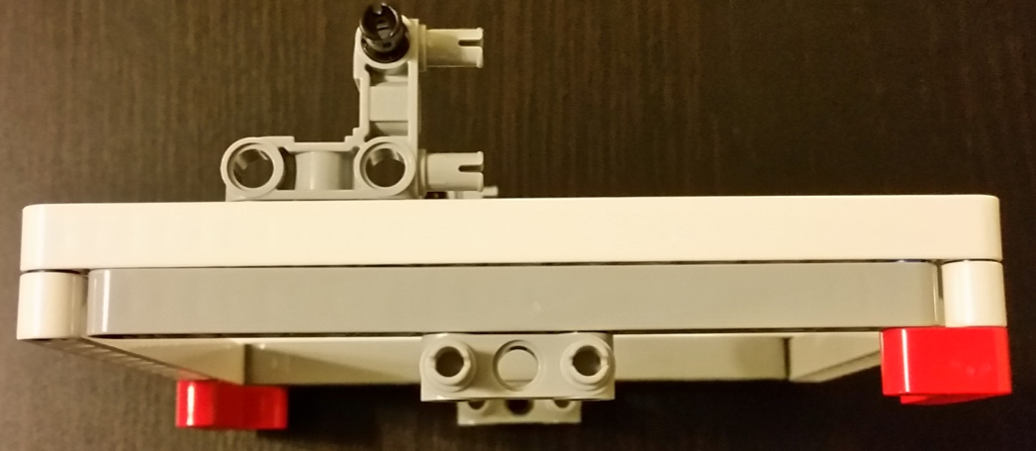
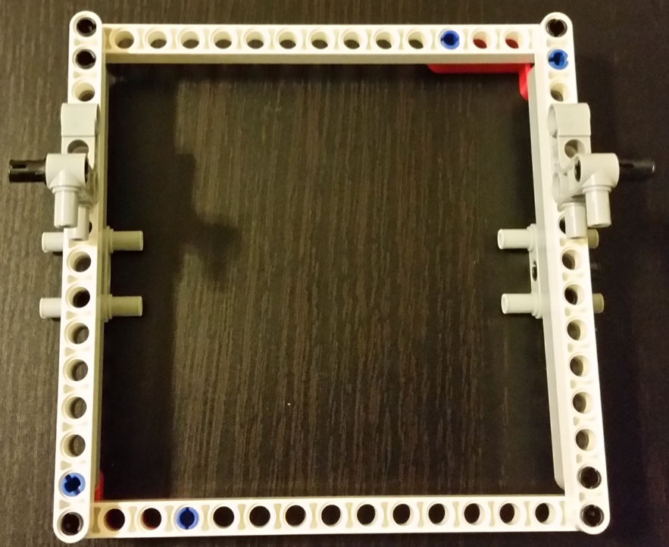
Construct Pillars
Side View
Top View

Slide 28
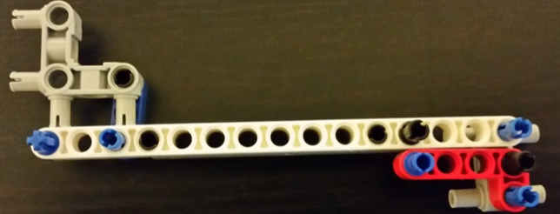
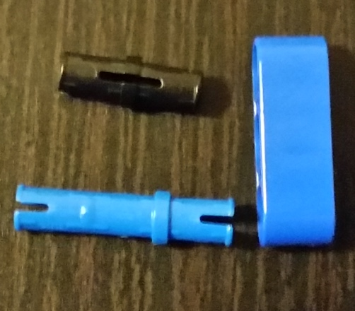
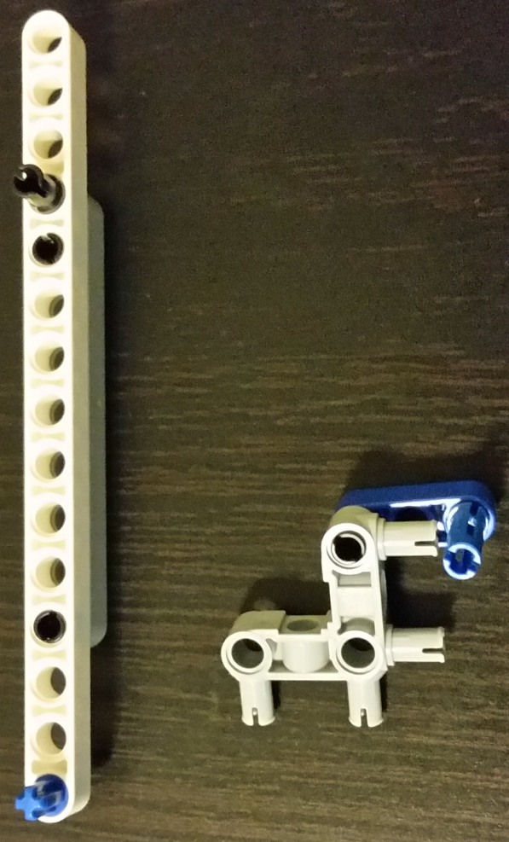
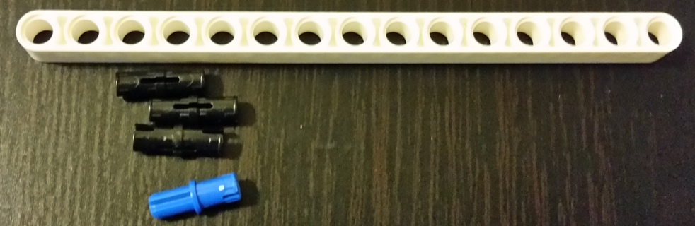
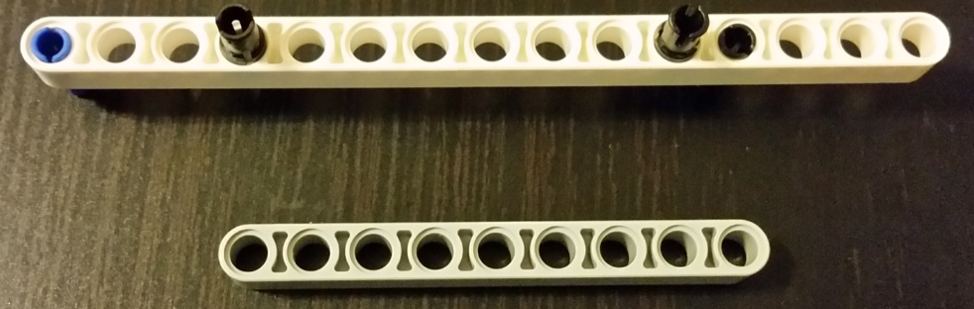
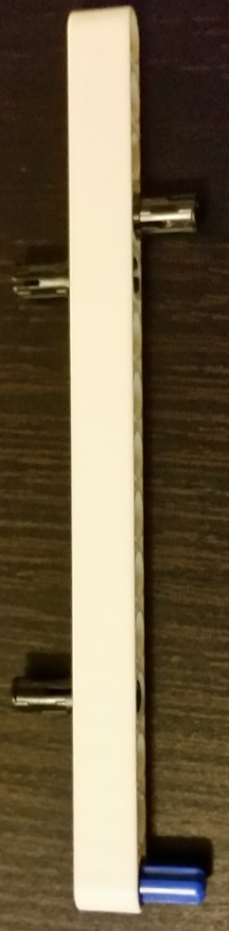
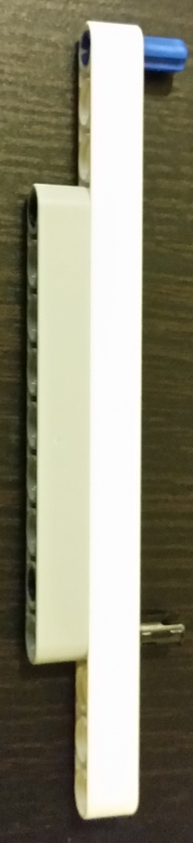
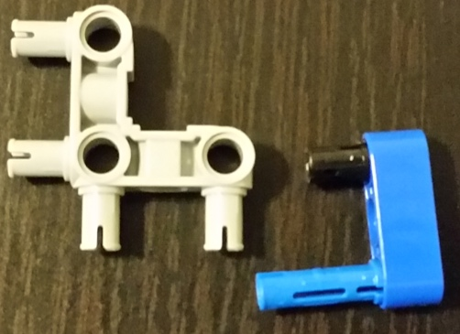
Construct Pillars
Repeat for other side

Slide 29





Construct Pillars
Repeat for other side

Slide 30



Construct Pillars
Repeat for other side

Slide 31


Construct Pillars
Repeat for other side

Slide 32







Construct Top

Slide 33



Complete the structure

Slide 34




Complete the structure

Slide 35





Construct the lift

Slide 36





Connect lift and structure
Small thread

Slide 37




Build mount for pulley motor

Slide 38




Mount the pulley motor
Make sure to wrap the thread around the motor shaft

Slide 39

Elevator Wiring
Port A – Pulley Motor
Pulley motor

Slide 40


Assembled Elevator
Top View
Side View

Slide 41
Move the Elevator
public class Elevator {
public static void main(String[] args) {
NXTRegulatedMotor pulleyMotor = Motor.A;
// Move up
pulleyMotor.rotate(360 * 2);
pulleyMotor.rotate(180);
// Move down
pulleyMotor.rotate(-360 * 2);
pulleyMotor.rotate(-180);
}
}

Slide 42
Trigger with Button
public class Elevator {
public static void main(String[] args) {
NXTRegulatedMotor pulleyMotor = Motor.A;
// Move up
pulleyMotor.rotate(360 * 2);
pulleyMotor.rotate(180);
// Move down
pulleyMotor.rotate(-360 * 2);
pulleyMotor.rotate(-180);
}
}

Slide 43
Turn off with Light Switch
public class Elevator {
public static void main(String[] args) {
NXTRegulatedMotor pulleyMotor = Motor.A;
// Move up
pulleyMotor.rotate(360 * 2);
pulleyMotor.rotate(180);
// Move down
pulleyMotor.rotate(-360 * 2);
pulleyMotor.rotate(-180);
}
}

Slide 44
Putting it all together…
Can you write a program that will:
Move up the lift
Move down the lift
Use the button to trigger motion
If lift is up, it should go down
If lift is down, it should go up
Exit the program automatically, by using the sensor

